Slide 1
Noise Performance of Inverting and Non-inverting Amplifier Circuits -Implementation in MATLAB® SimRF
Application Note
Sheila P. Werth, Natasa Trkulja, Ali Magzari,
Stephen J. Bitar & Sergey N. Makarov
ECE Dept. WPI, Worcester, MA
August 24th 2011

Slide 2
Outline
Goal
Two types of a matching circuit
Two basic op-amp configurations
Comparing two noisy circuits
Noise analysis and comparison-Theory and SimRF
RF low-frequency power detector – circuit schematic
RF low-frequency power detector – switching capacitors
RF low-frequency power detector – coil configuration
RF low-frequency power detector – Ultiboard setup/photo
Demo
Future work
Notes:
Ali

Slide 3
Our goal
Compare two different noisy circuits in SimRF
RF power meter
Low frequency wideband communications
Notes:
Ali

Slide 4
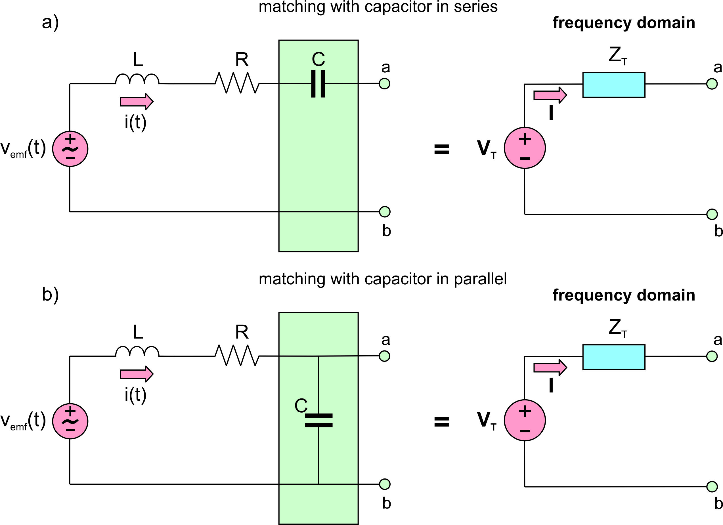
Two types of matching circuit
At the resonant frequency:
Notes:
Sheila

Slide 5
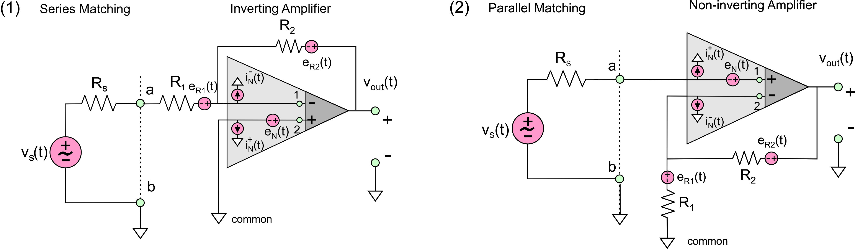
Two basic op-amp configurations
Inverting configuration :
Non- inverting conf.:
Notes:
Sheila

Slide 6
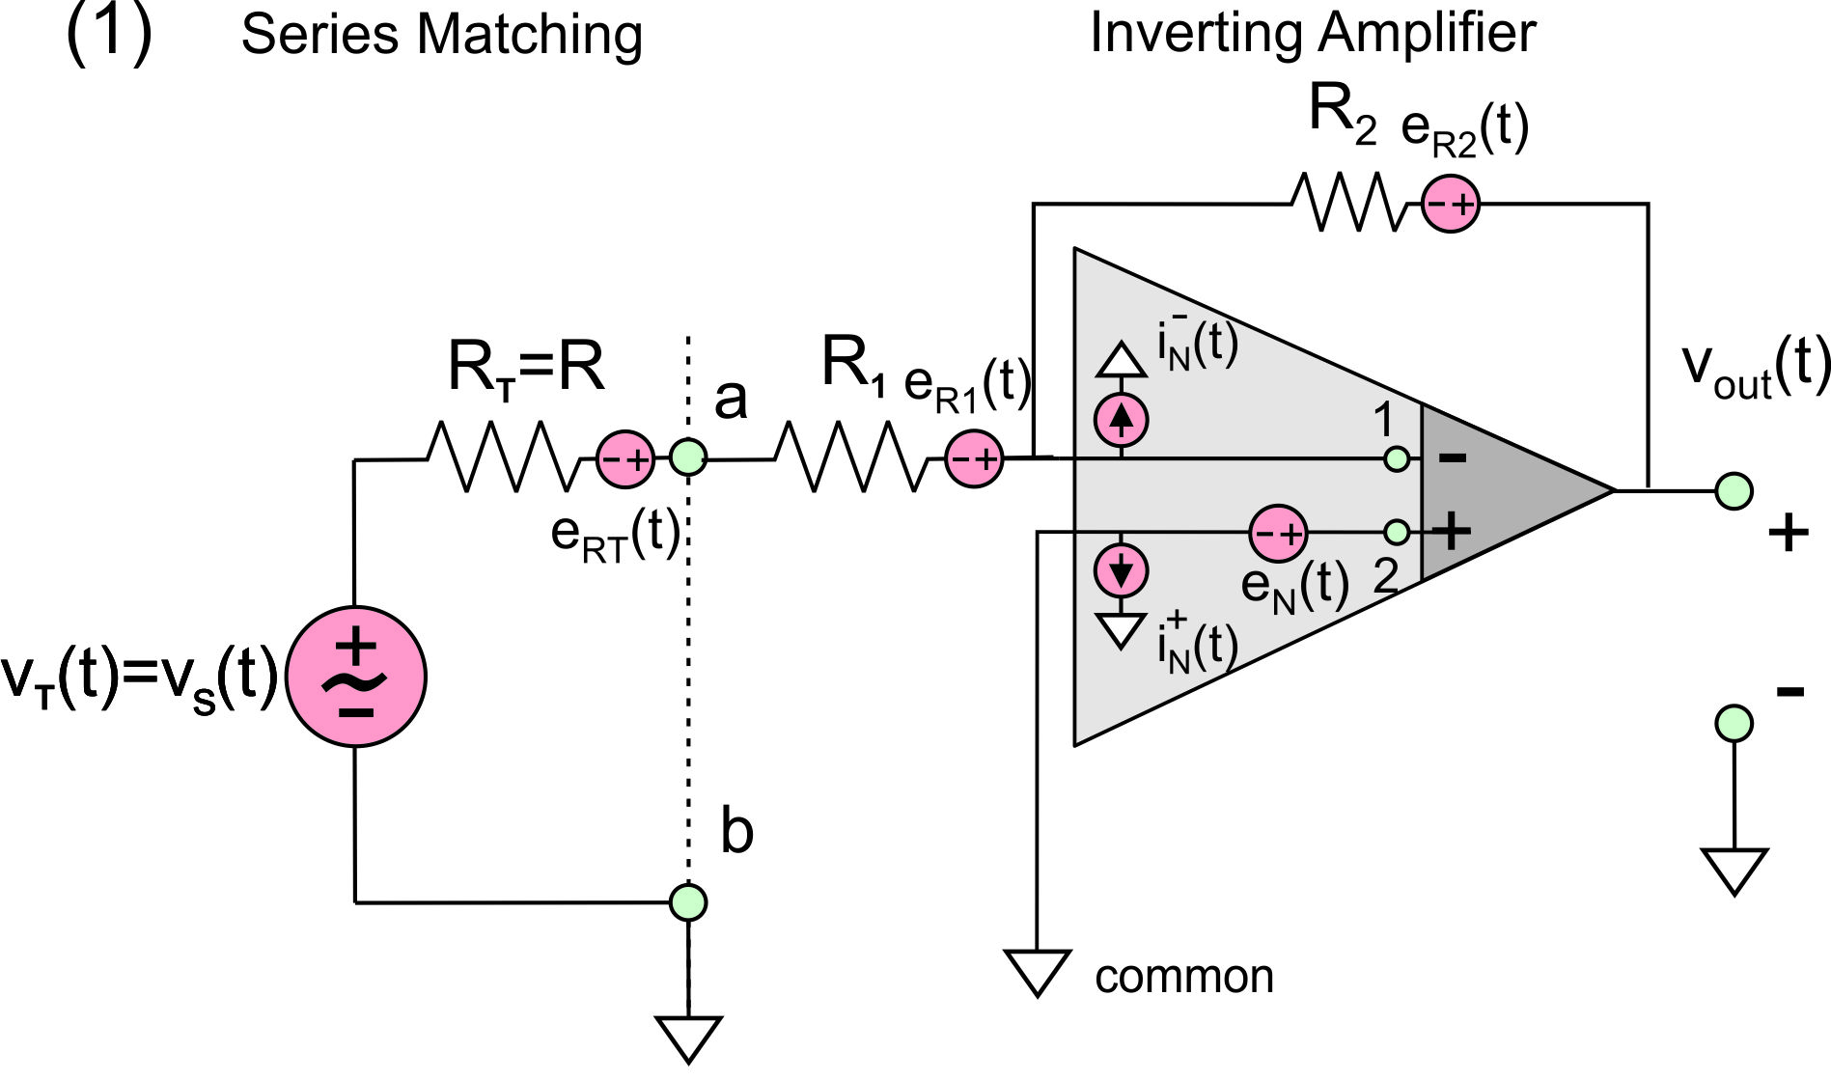
Comparing two noisy circuits
(1) series/inverting
In our circuit:
For a resonant frequency
Inverting amplifier gain:
Total circuit gain:
Notes:
Sheila

Slide 7
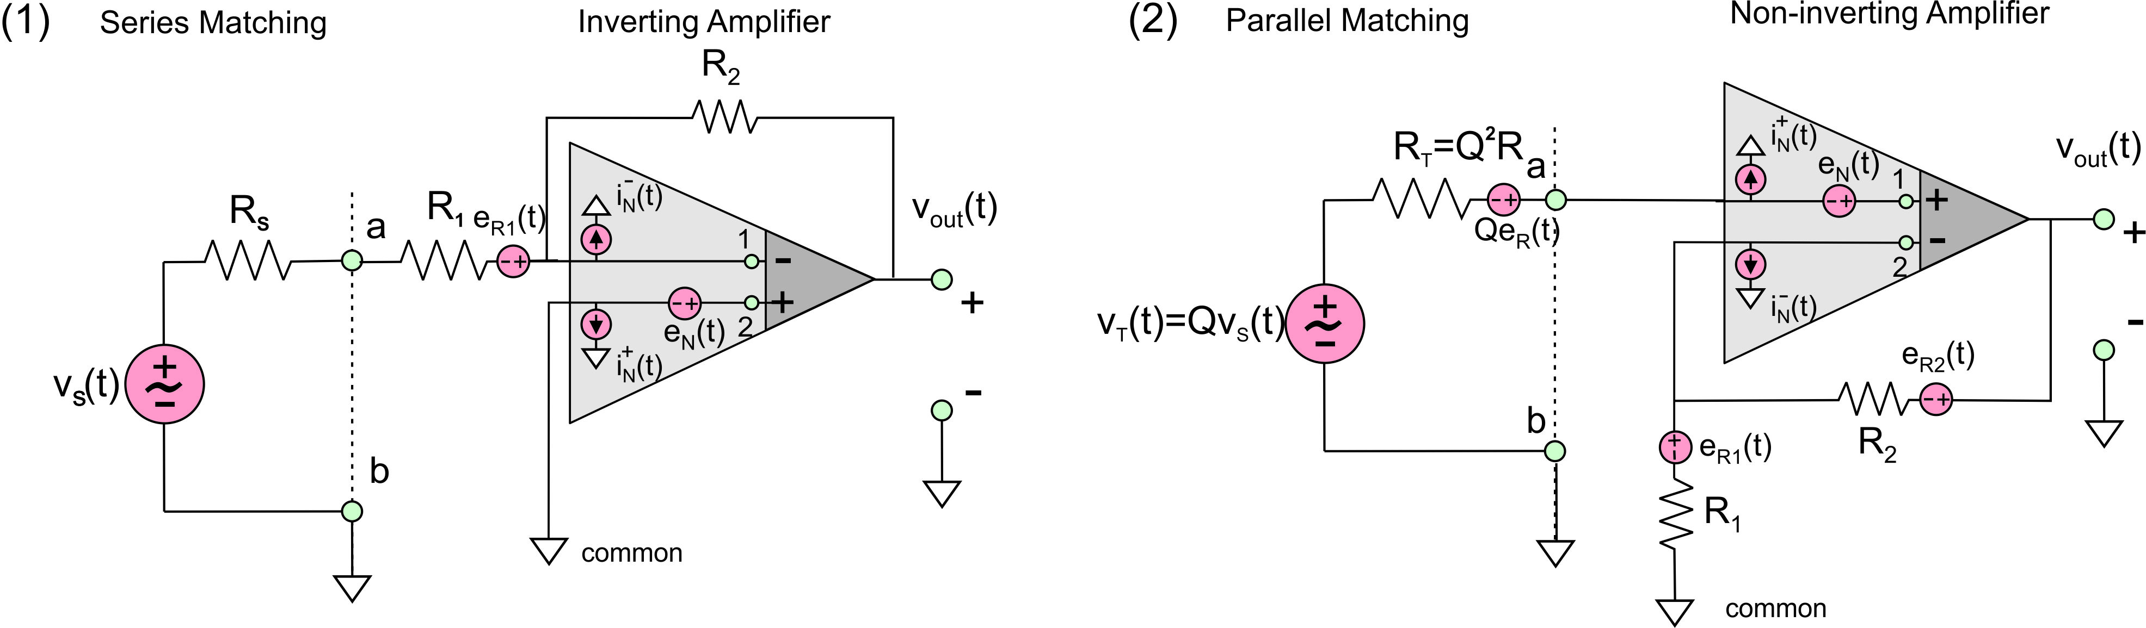
Comparing two noisy circuits
(2) parallel/non-inverting
In our circuit:
For a resonant frequency
Non-inverting amplifier gain:
Total circuit gain:
Notes:
Sheila

Slide 8
Noise Analysis-Theory
Series/Inverting:
The noise generated by the antenna resistance is given by:
After passing through the amplifier this becomes:
The equivalent input noise to the amplifier is :
The total predicted rms output noise is :
Parallel/Non-inverting:
The noise generated by the antenna resistance is given by:
Multiplying by the total circuit gain the noise that enters
the amplifier due to the resistor is:
The equivalent input noise to the amplifier is:
Notes:
Sheila

Slide 9
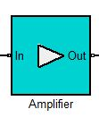
Reminder: MATLAB script for finding the noise figure using the previous analysis:
Notes:
Sheila

Slide 10
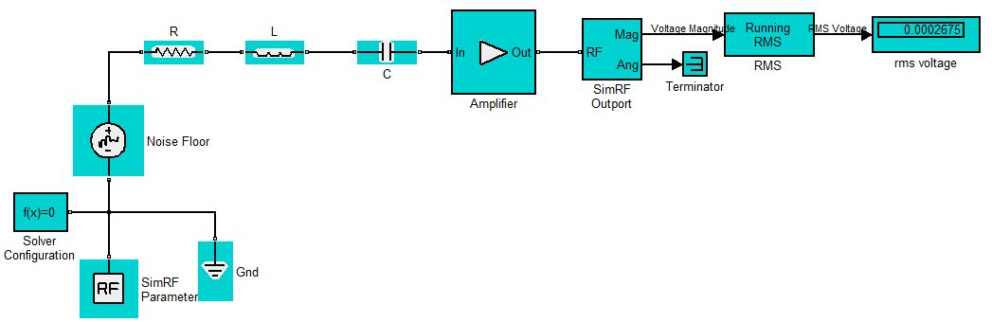
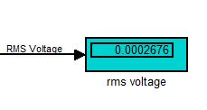
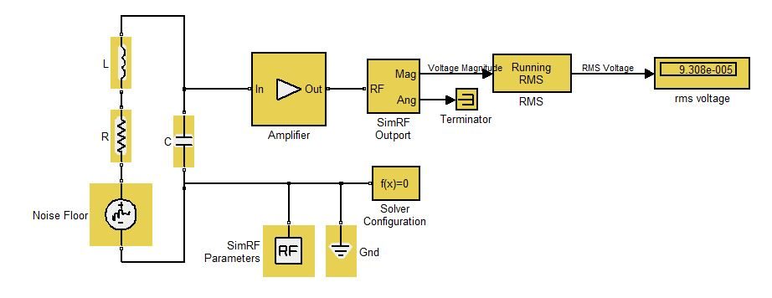

SimRF set-up and results
Series/Inverting
Parallel/Non-Inverting
Notes:
Sheila

Slide 11
Comparison with theory
Series/Inverting:
The calculated rms output voltage (Theory) was:
The output from the experimental setup was a close match:
Parallel/Non-Inverting:
The calculated rms output voltage (Theory) was:
The output from the experimental setup was a close match:
*The experimental setup calculates a running rms so this could be a source of error.
Notes:
Sheila

Slide 12
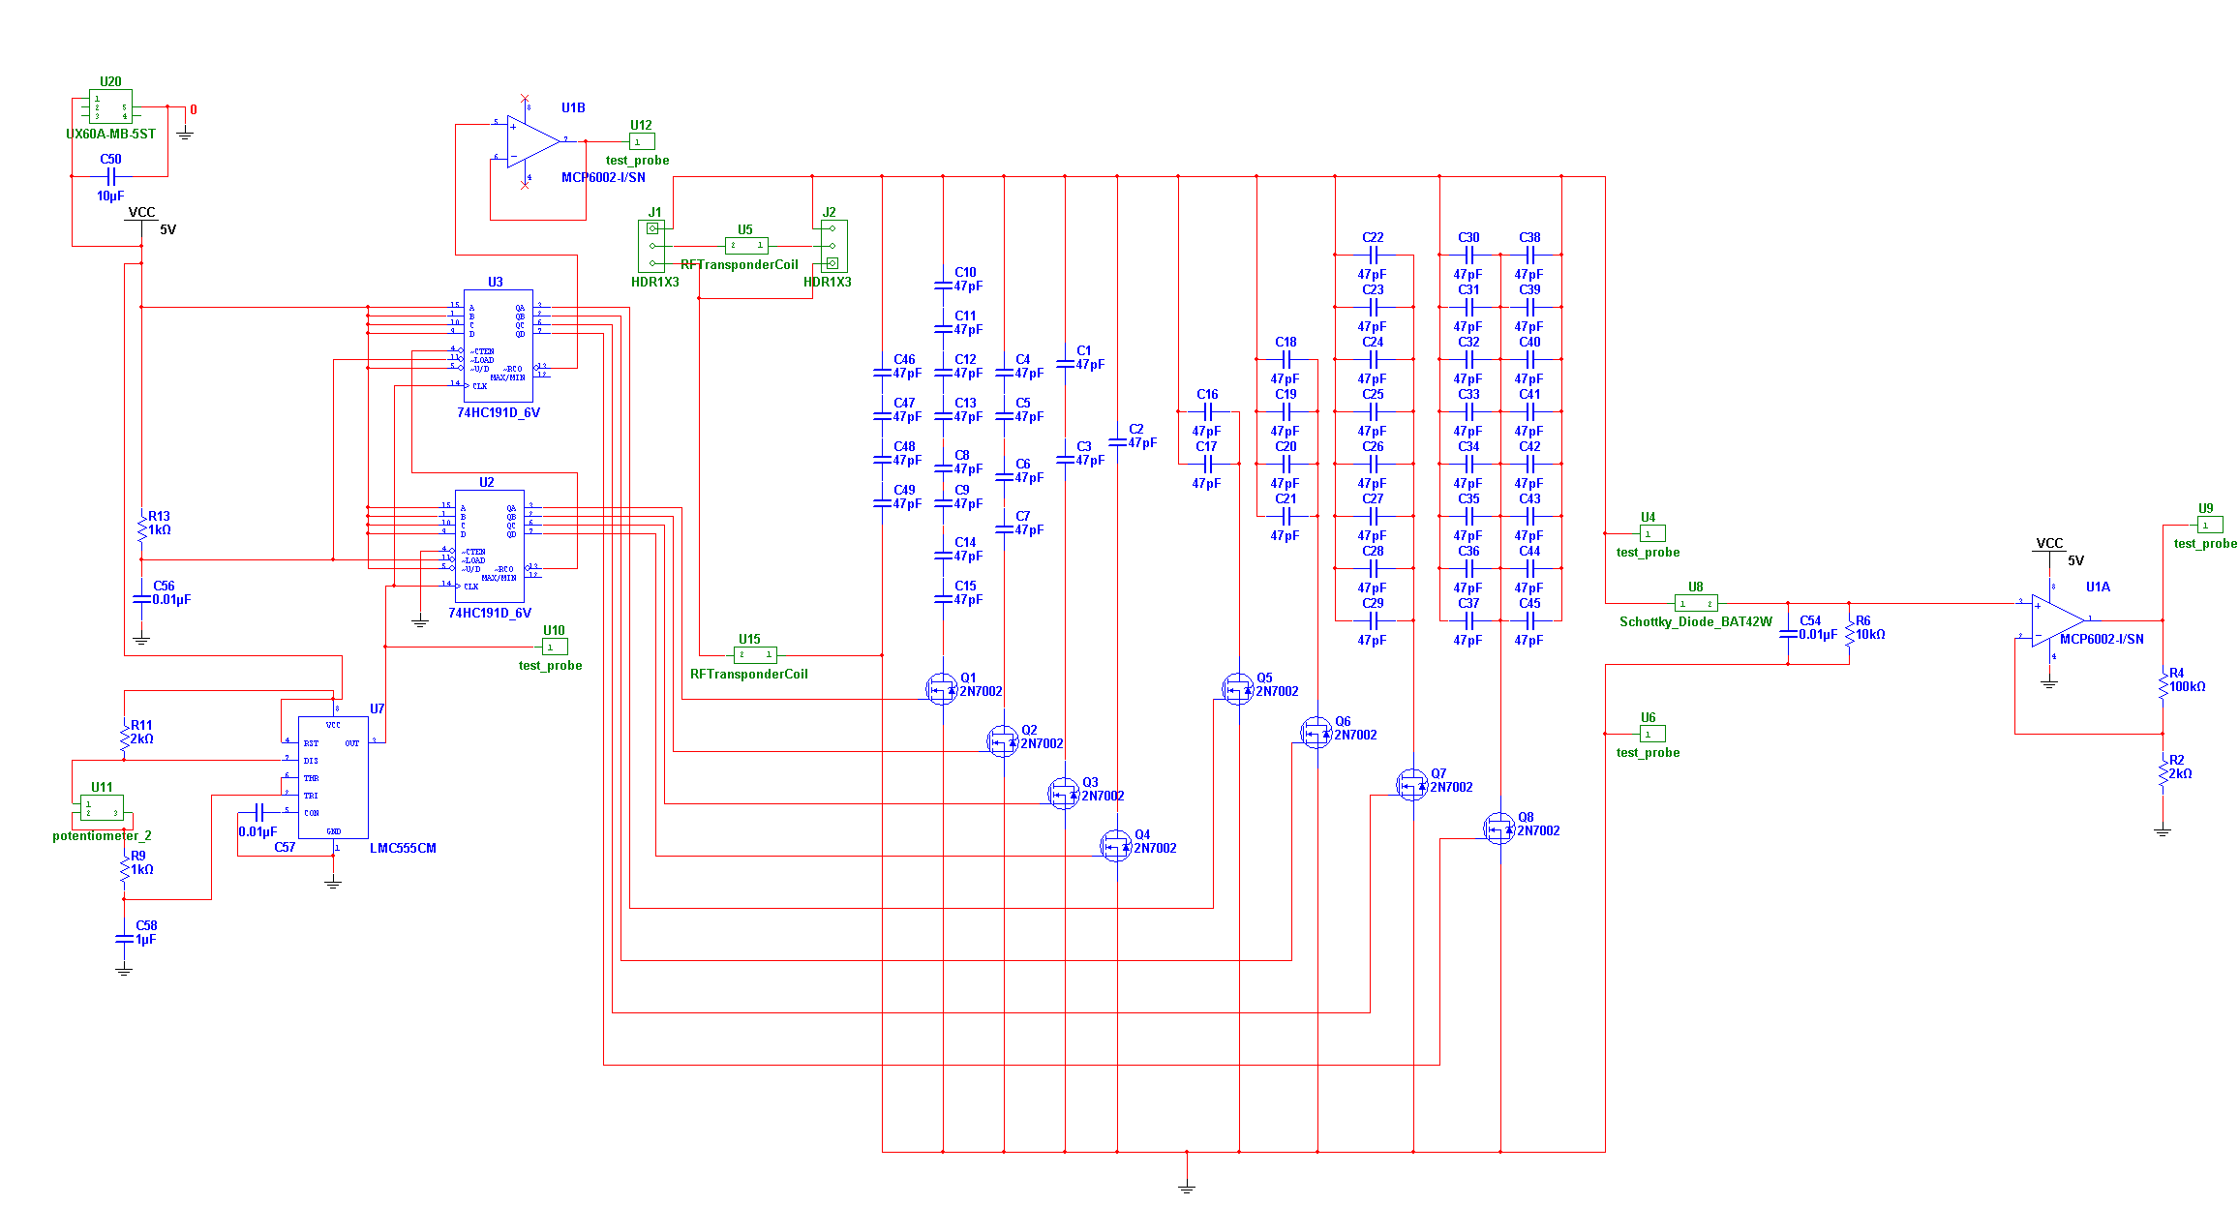
Circuit Schematic (RF power meter)
Notes:
Ali

Slide 13
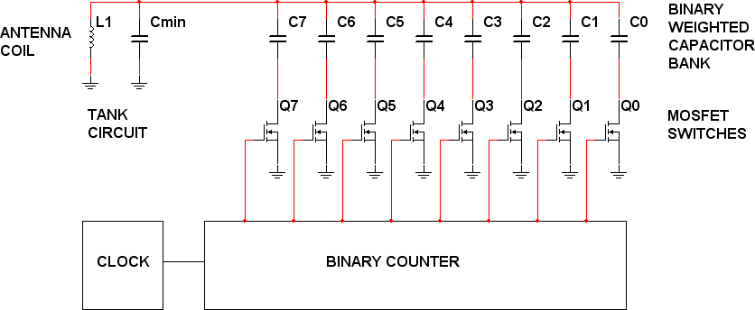
Switching Capacitor Bank
Notes:
Ali

Slide 14
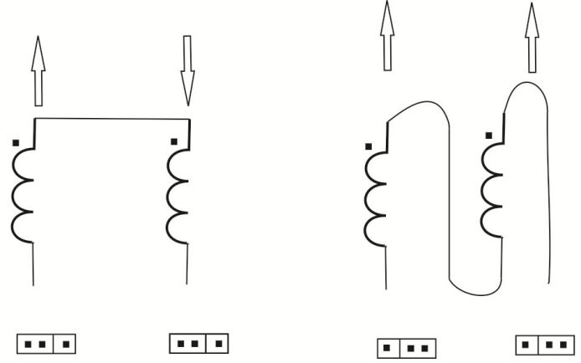
Coil Configuration
Notes:
Natasa

Slide 15
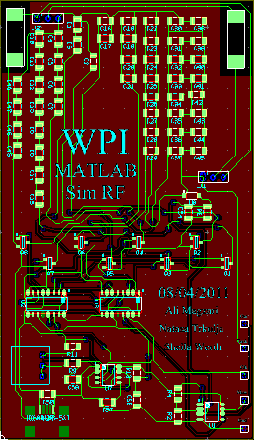
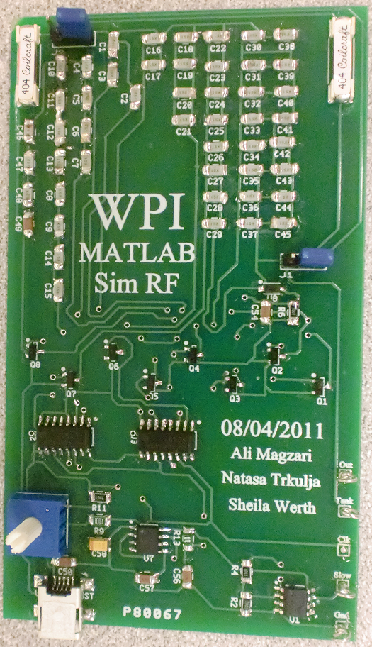
Ultiboard Setup
Notes:
Natasa

Slide 16
Future Work
Exclude the ground plane since it increases the capacitance.
Use capacitors with no inductance to increase the frequency range.
Use different type of coils in order to improve circuit sensitivity.
Include the non-inverting amplifier before the peak detector.
Have a built-in screen indicating the resonant frequency.
Notes:
Natasa

